Slide 1
AE/Dst Indices vs Microburst Occurrence

Slide 2
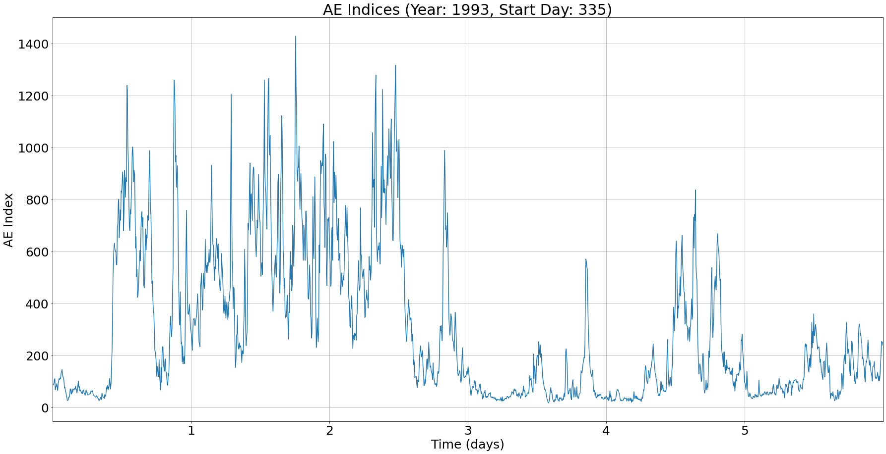
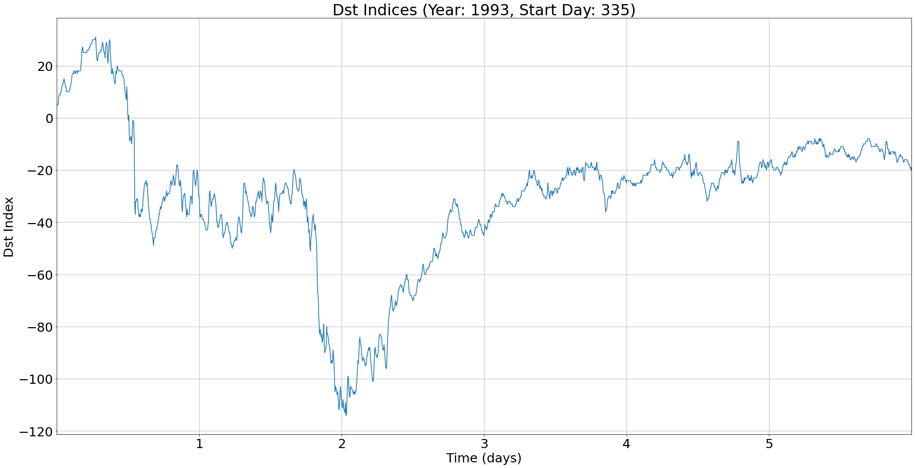
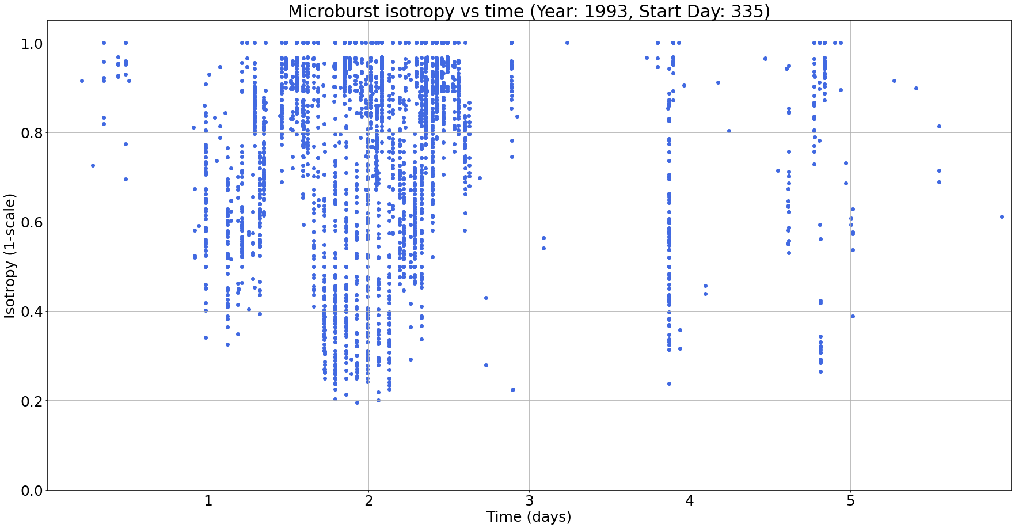
Intro
a)
b)
c)
By observing the AE/Dst index plots (a & b) and the microburst isotropy plot over time (c), there is a correlation between these indices and the microburst occurrence.
To gain a better understanding of how geomagnetic storm indices effect the occurrence of microbursts during a given storm, we will analyze the comparison during each of the 9 <100nT storms.

Slide 3
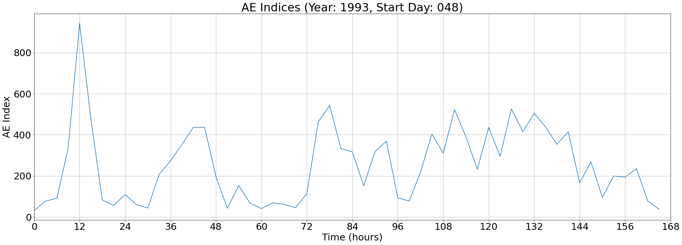
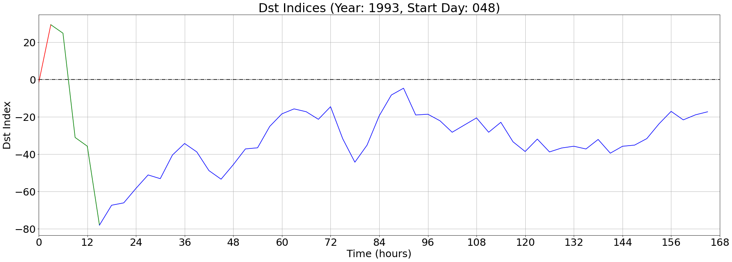
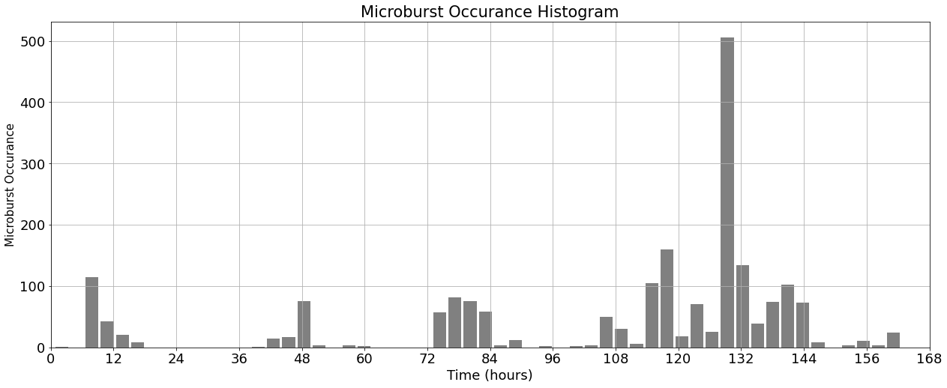
Storm 1: 1993048-1993054
Note that the spike in microburst occurrences is after the peak Dst in recovery phase
Remove last part of storm? (different storm)

Slide 4
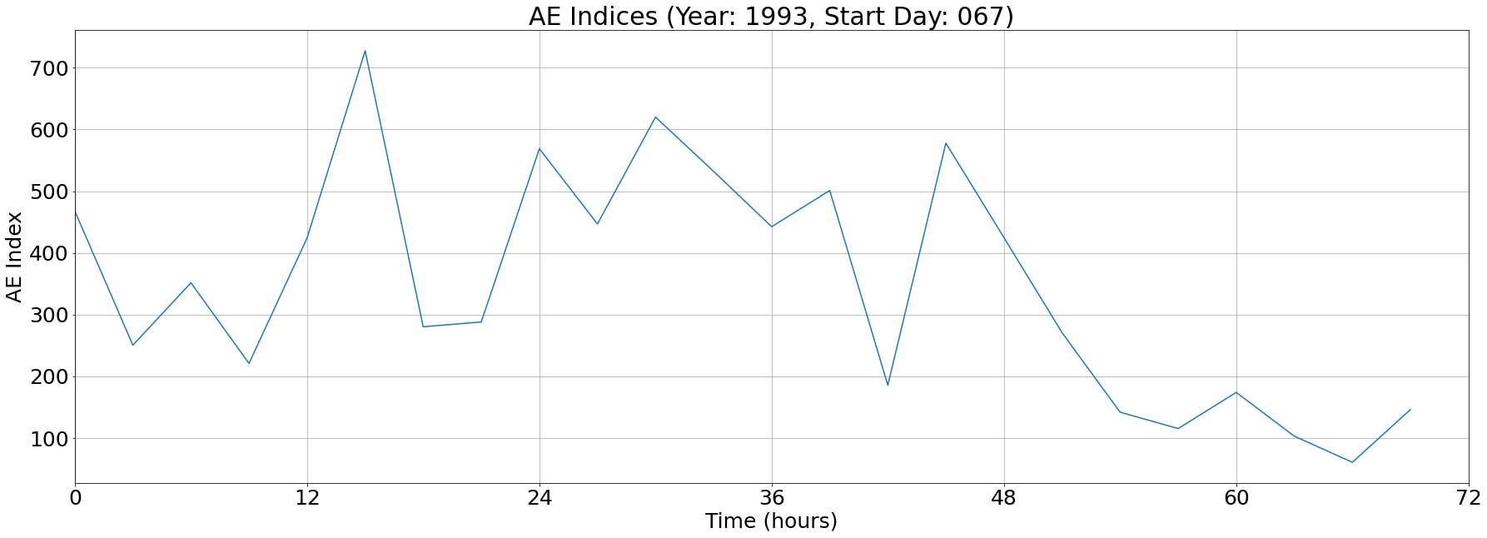
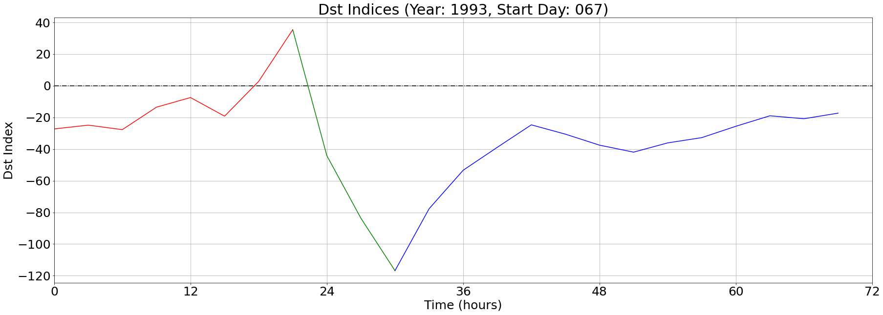
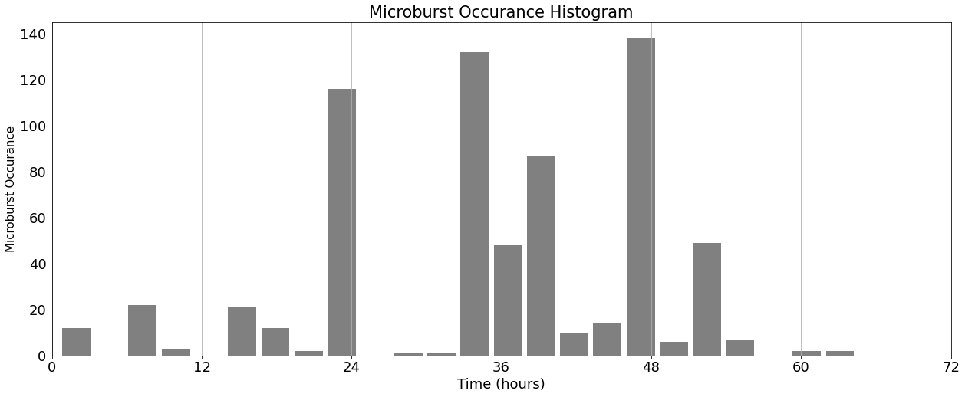
Storm 2: 1993067-1993069
Most microbursts occur in the recovery phase
Large gap in occurrences during main phase

Slide 5
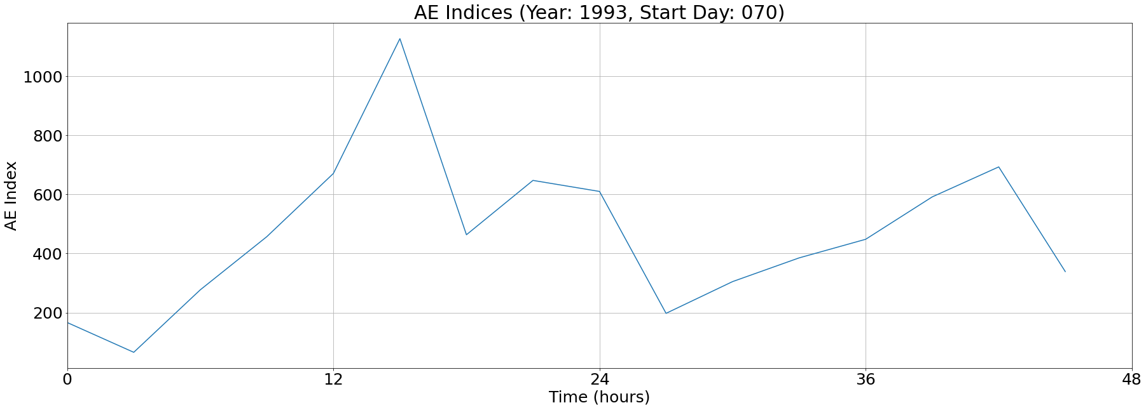
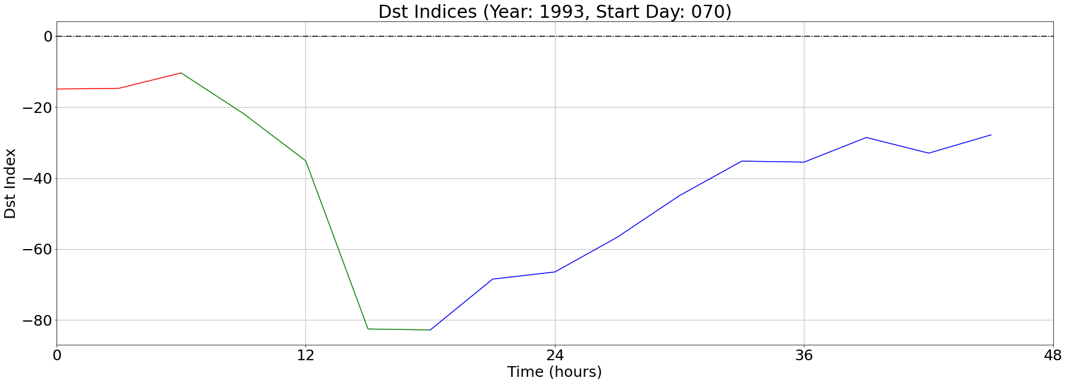
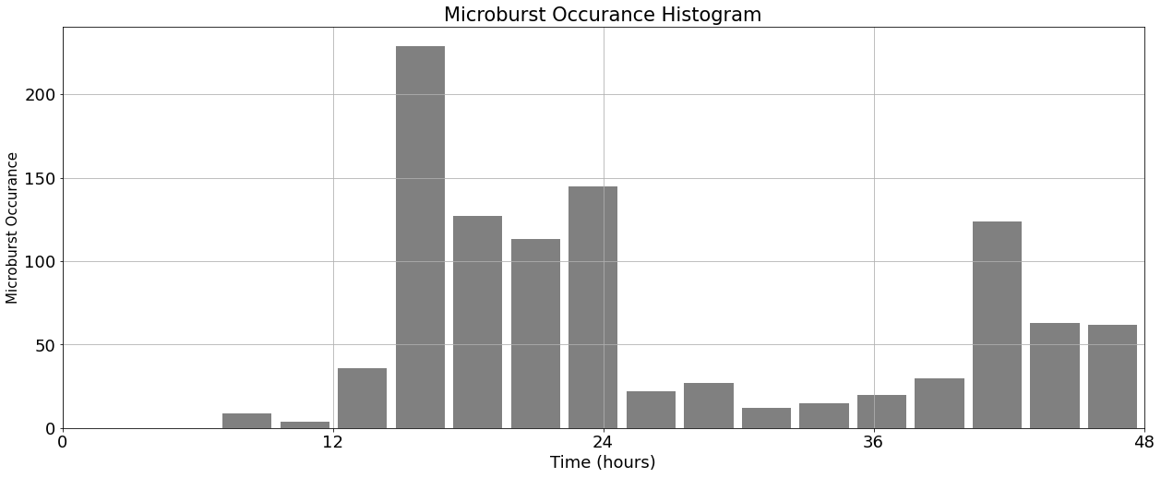
Storm 3: 1993070-1993071
Occurrence pattern follows AE indices in this storm

Slide 6
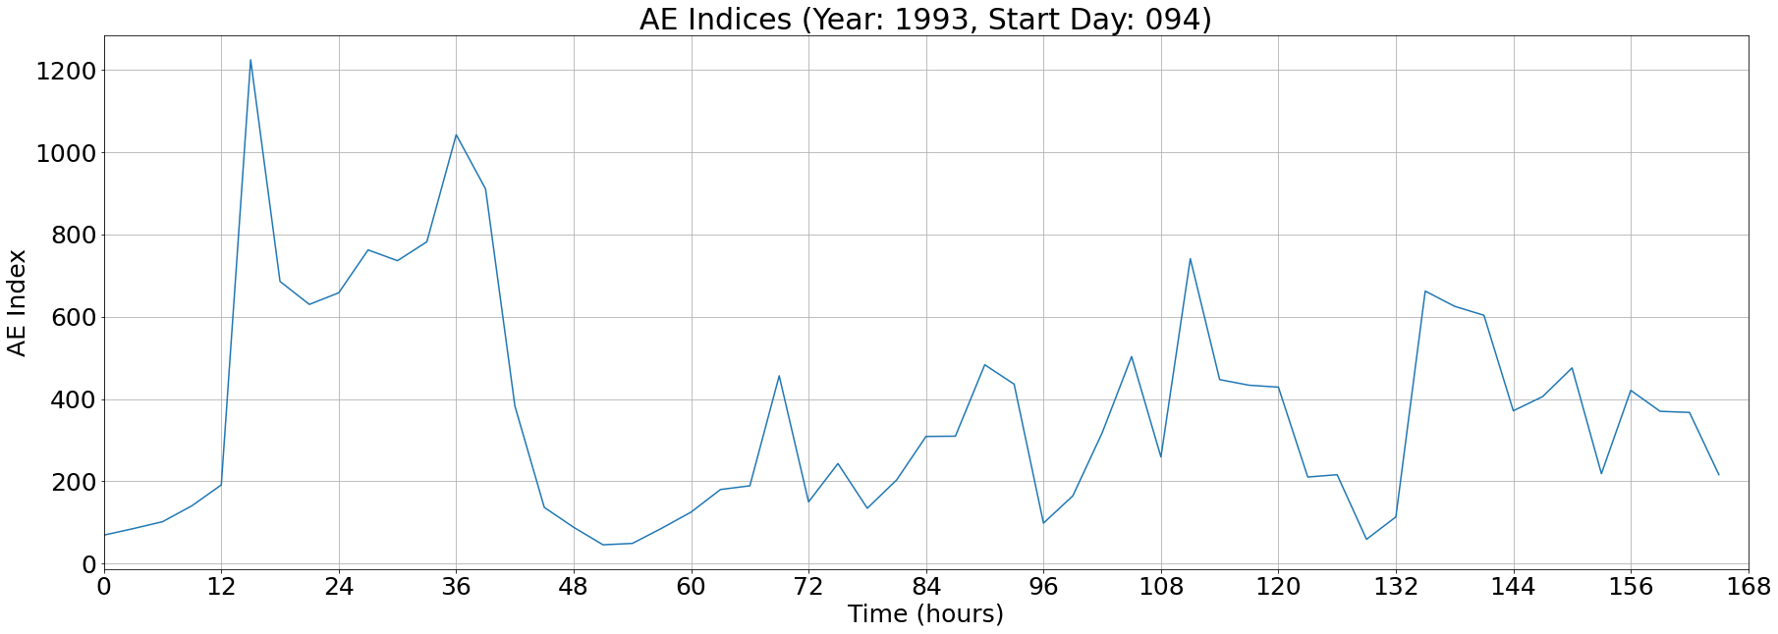
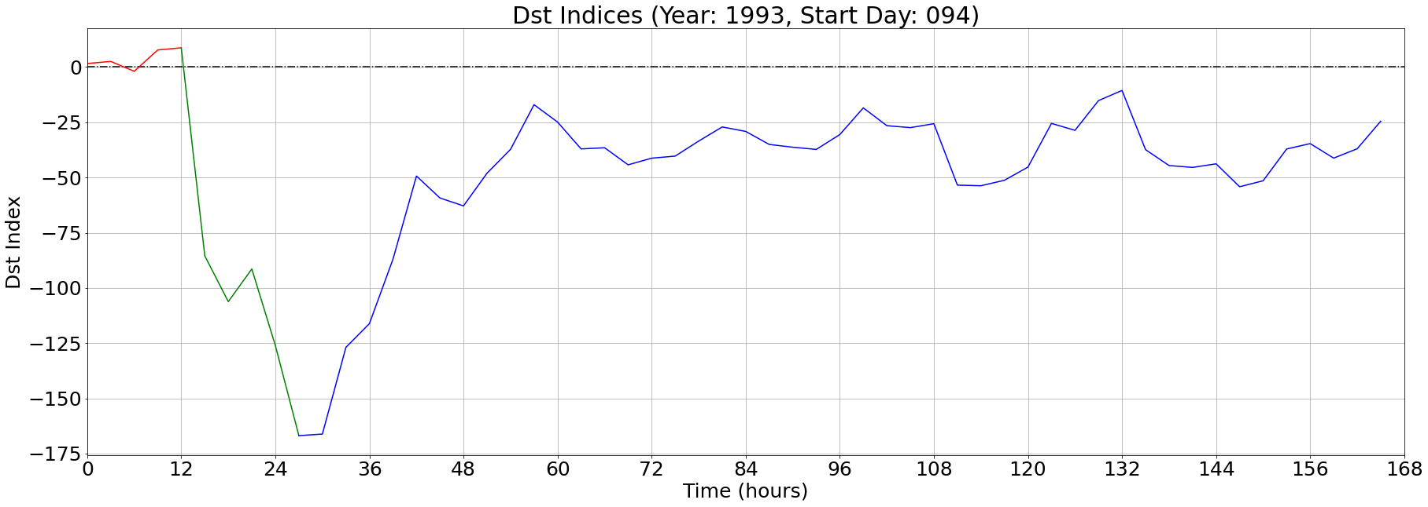
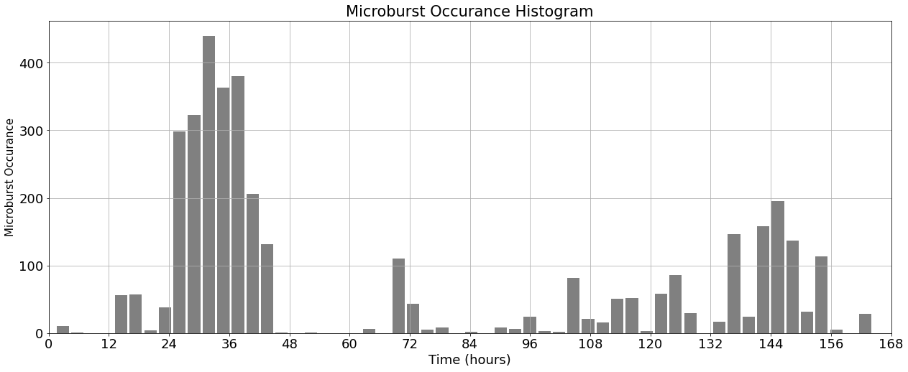
Storm 4: 1993094-1993100
Majority of microbursts occur at the boundary between main phase and recovery phase (once again)

Slide 7
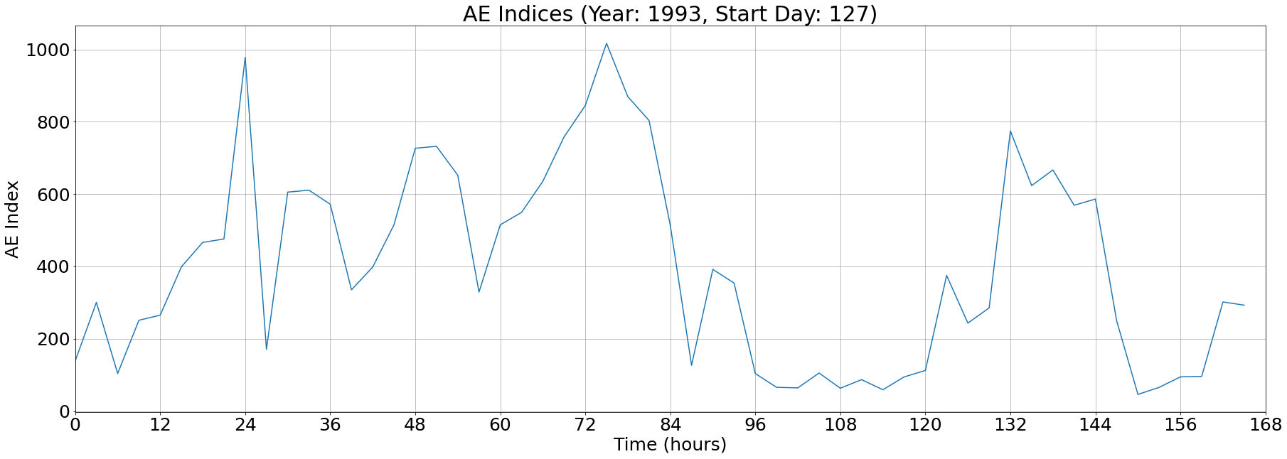
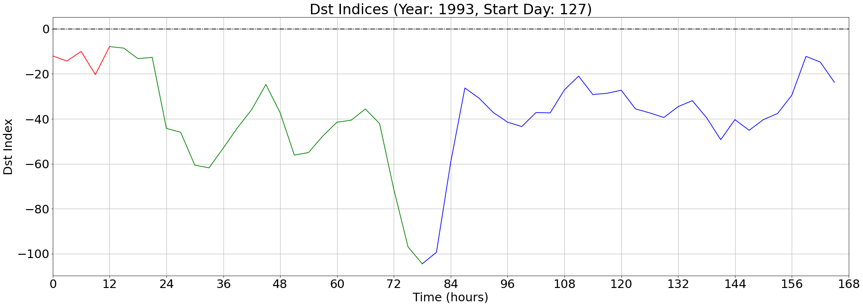
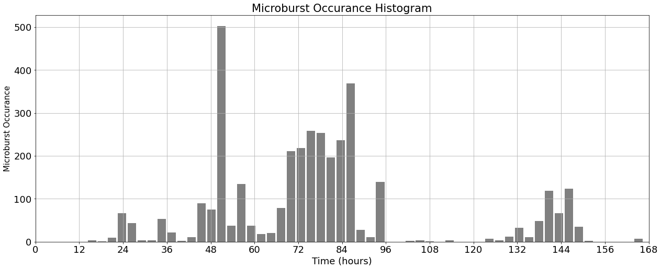
Storm 5: 1993127-1993133
Spike in occurrences during irregular main phase
Think about taking this one out of statistical analysis

Slide 8
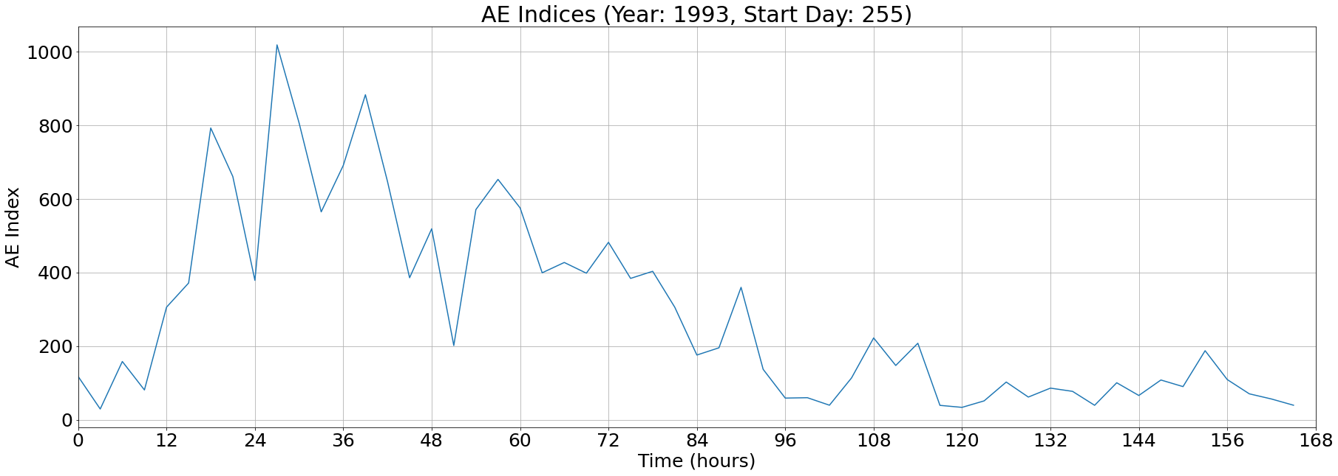
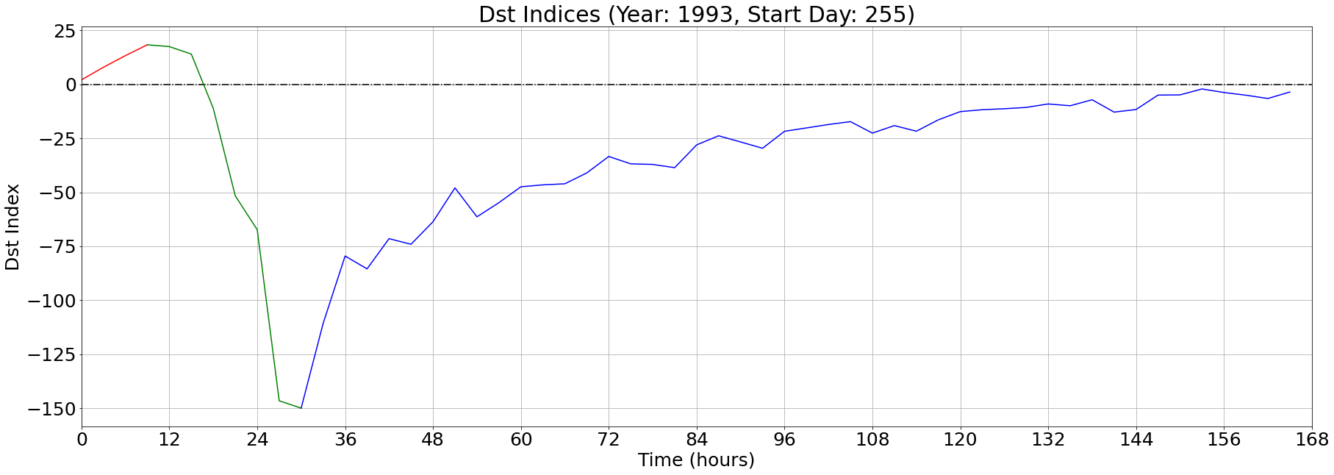
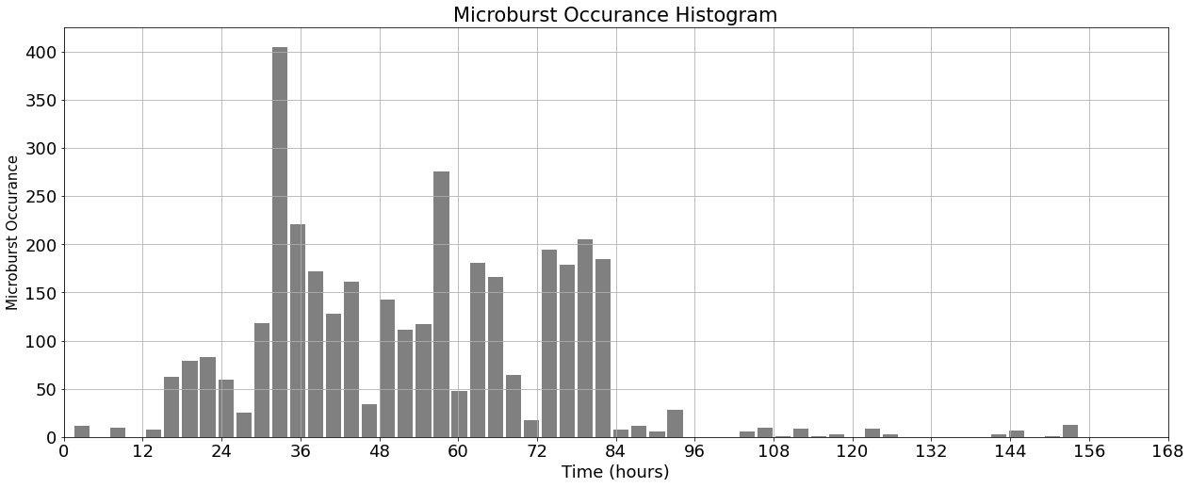
Storm 6: 1993255-1993261
Most microbursts occur immediately after the minimum Dst (once again)

Slide 9
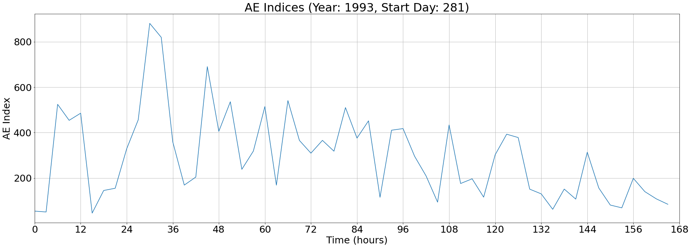
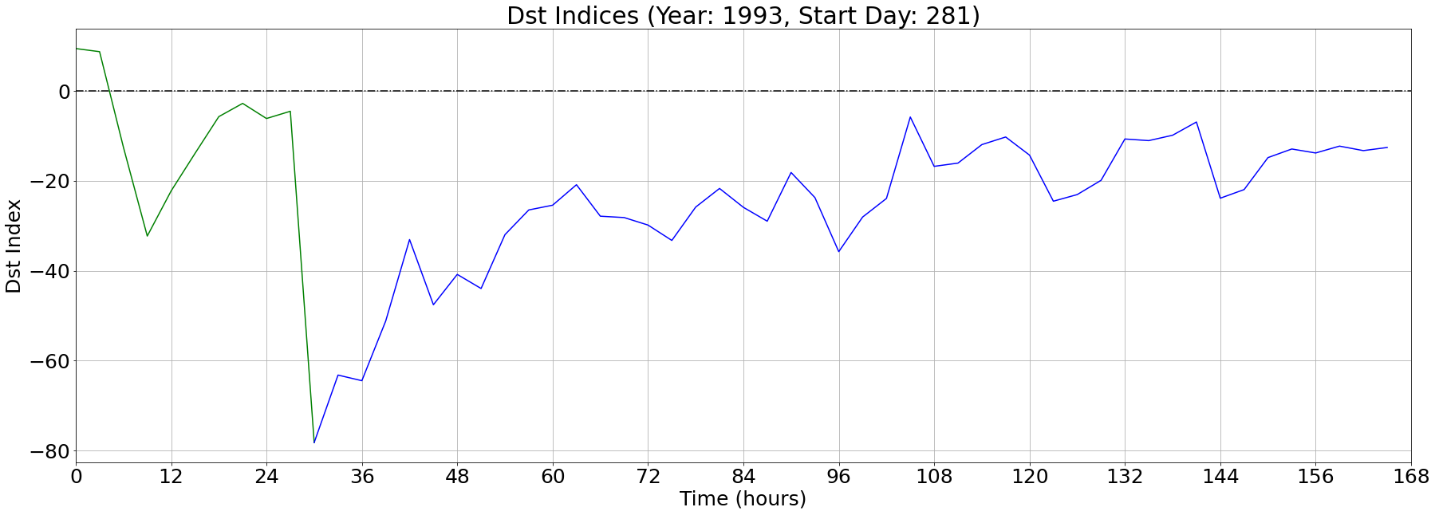
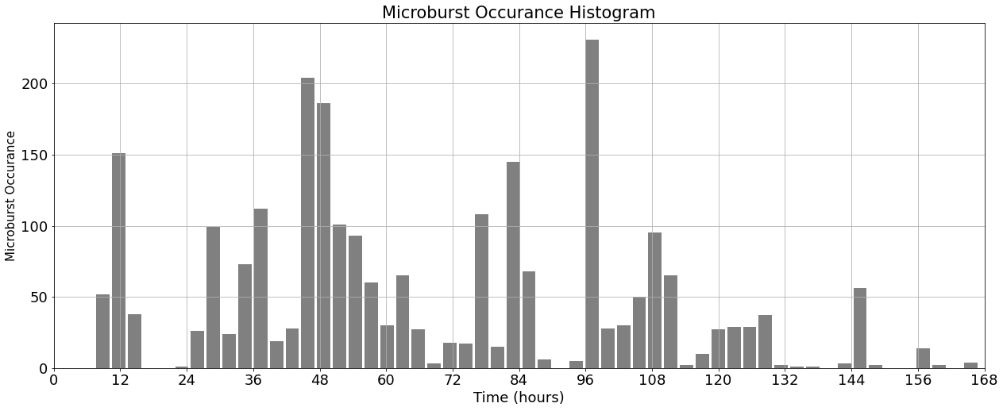
Storm 7: 1993281-1993287
Occurrences spread throughout phases

Slide 10
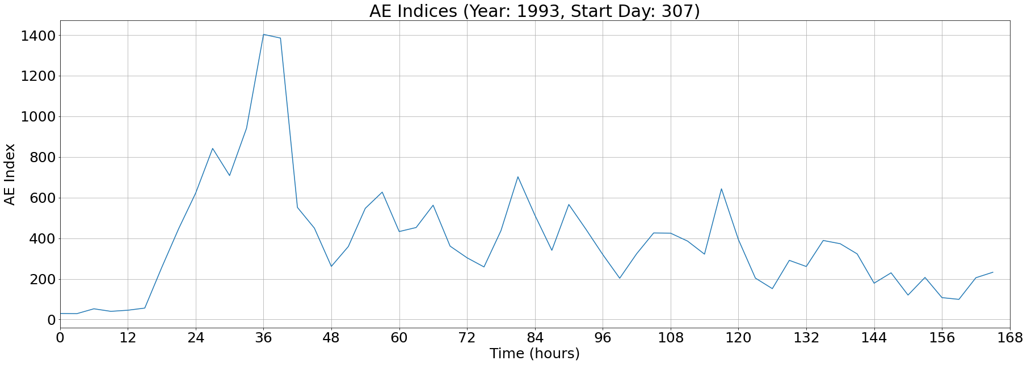
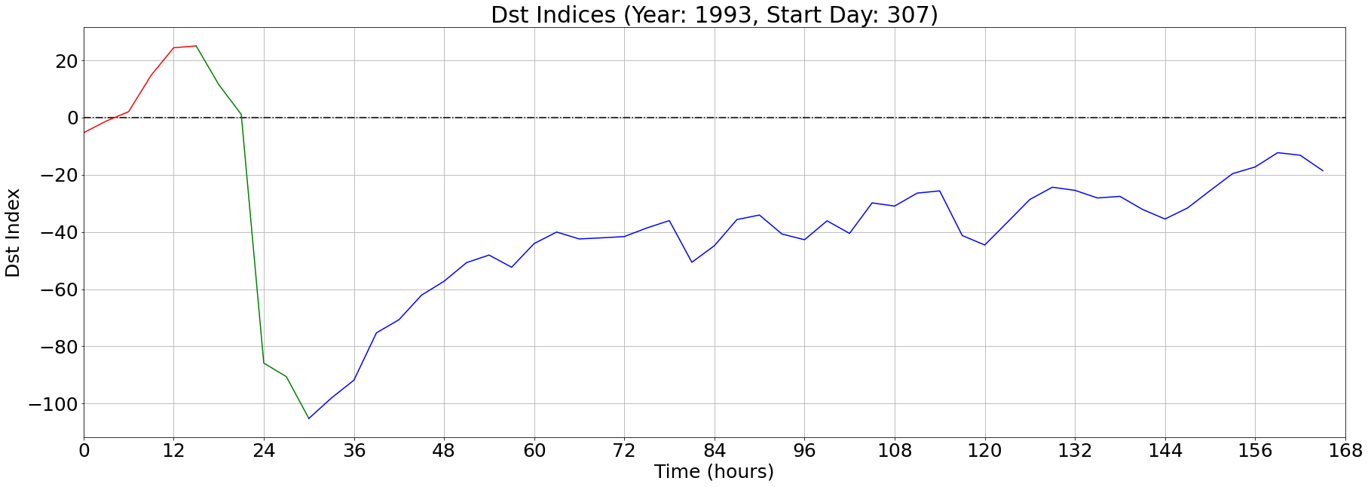
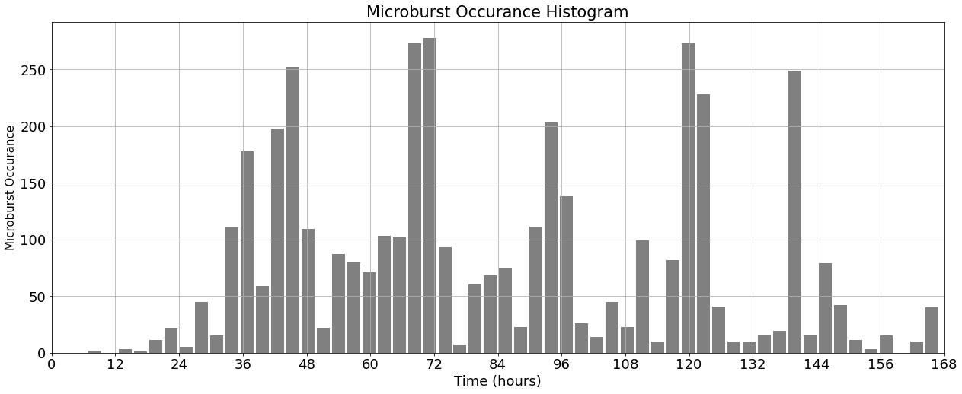
Storm 8: 1993307-1993313
Largely recovery phase occurrences

Slide 11
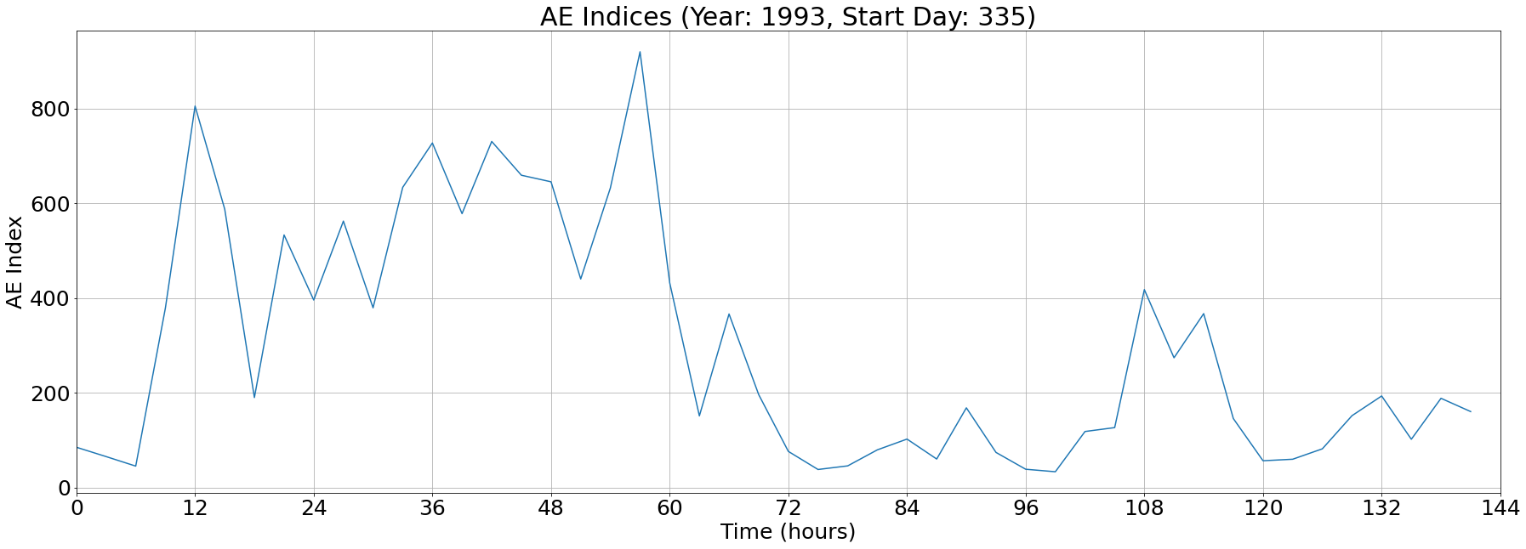
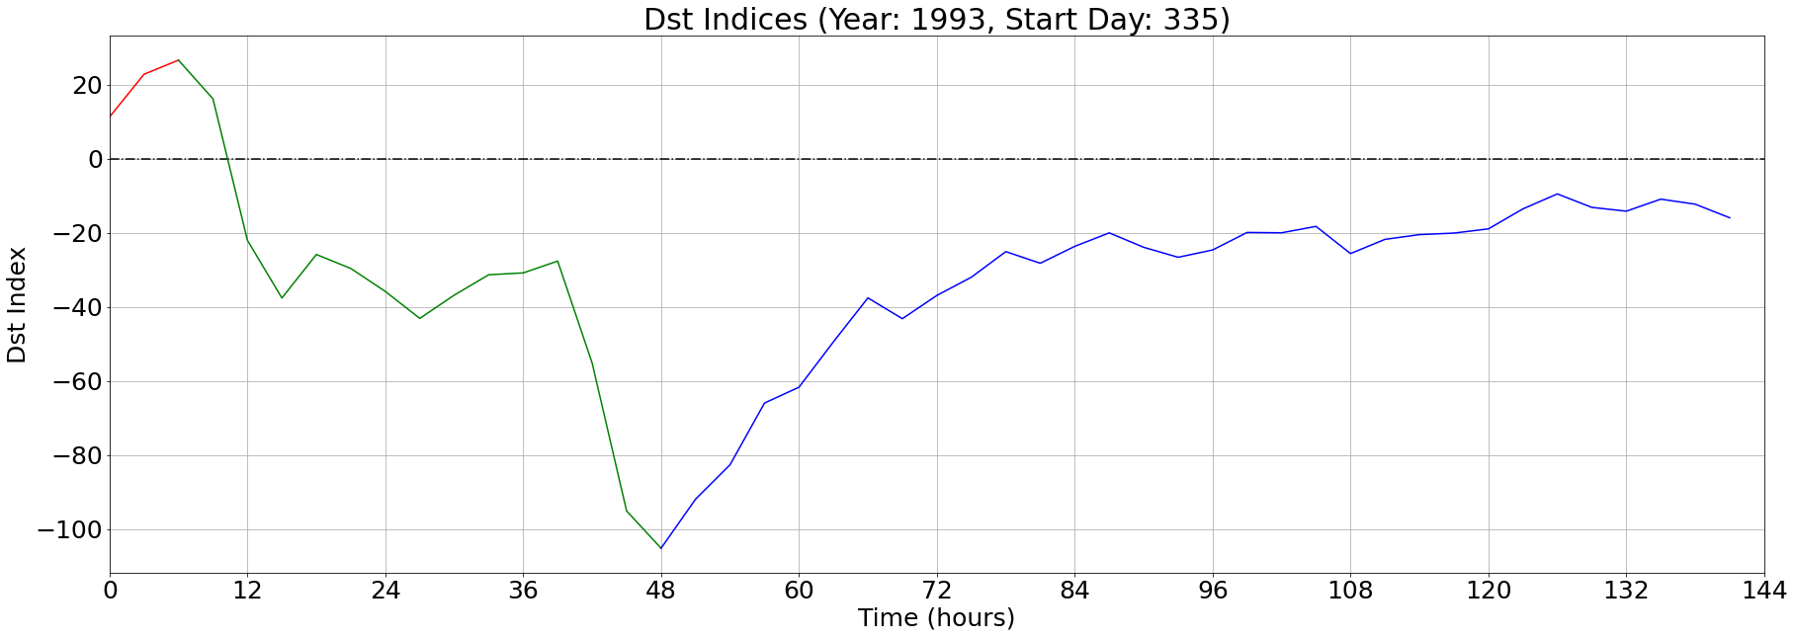
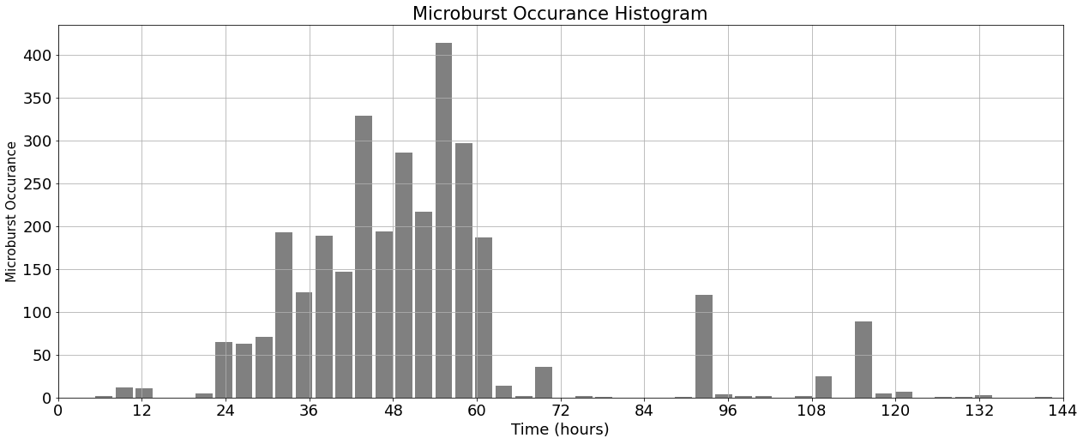
Storm 9: 1993335-1993340
Microburst occurrence build up during main phase, which peaks immediately following transition to recovery phase

